Slide 1
2/21 – 3/30
Dev Bhatia
Ultrafast Optics Laboratory
Boston University

Slide 2
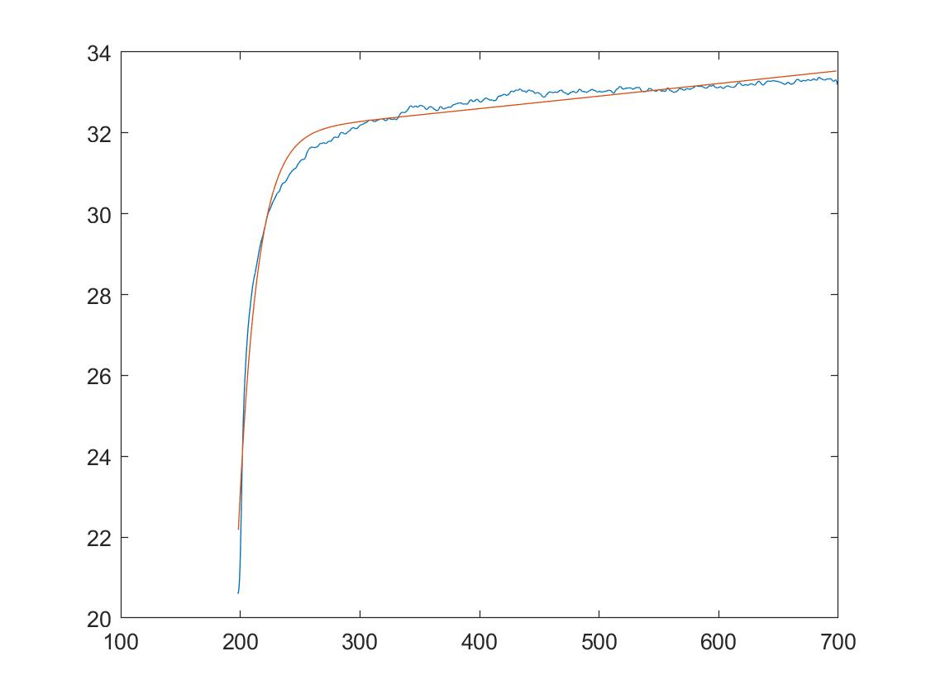
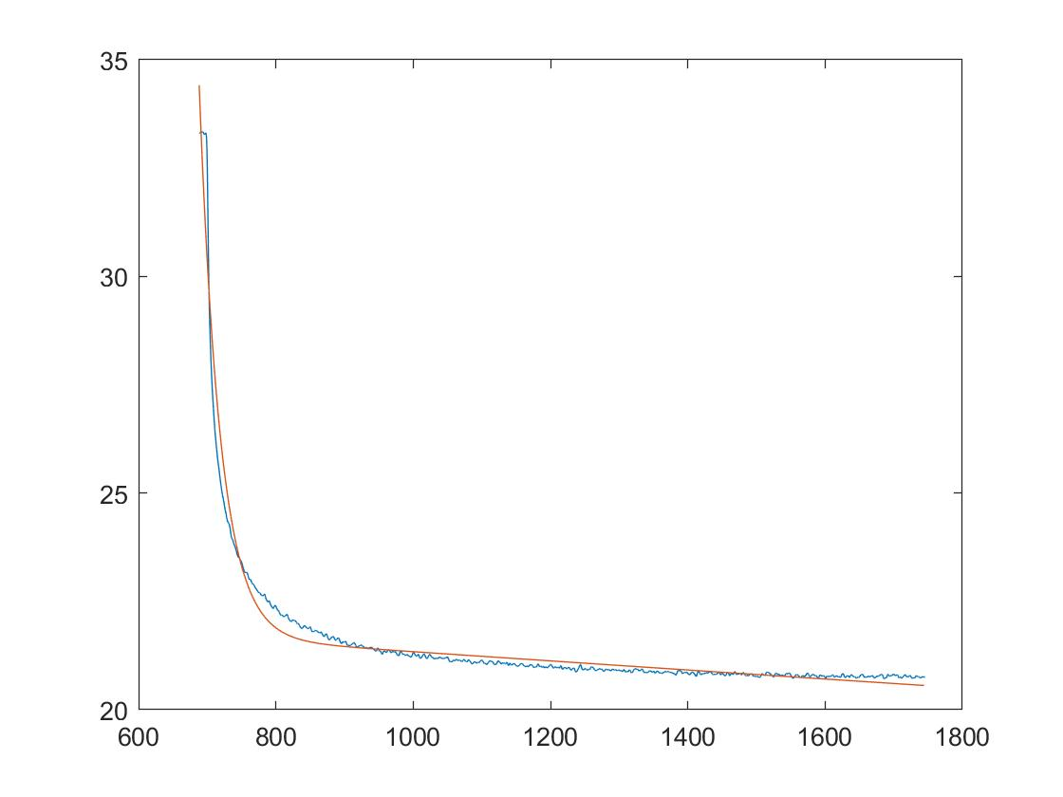
Temperature Fitting
General Model:
f(x) = a*exp(b*x) + c*exp(d*x)
200ns < t < 700ns
700 ns < t < 1700 ns
Fig 1. IR on Temp. Increase
Fig 2. IR off Temp. Decrease

Slide 3
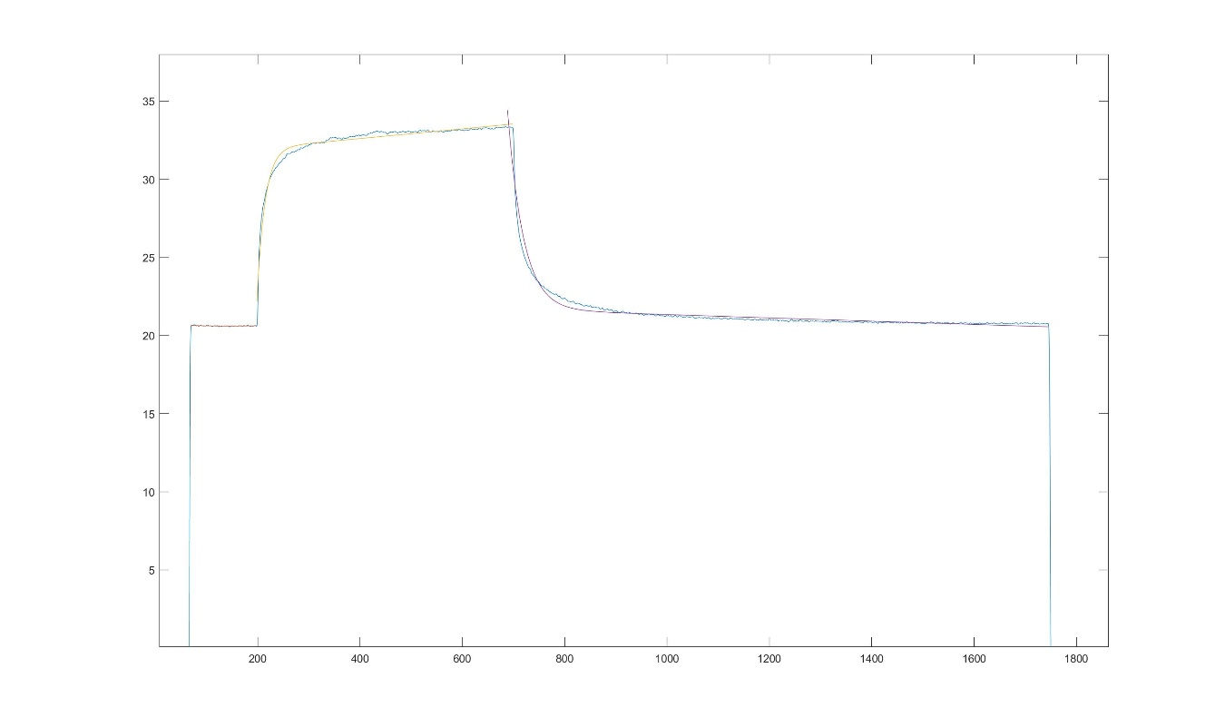

Temperature Fitting (2)
$$T=ae^{bt}+cⅇ^{dt}$$
Fig 3. Complete Temperature Depiction using Matlab

Slide 4
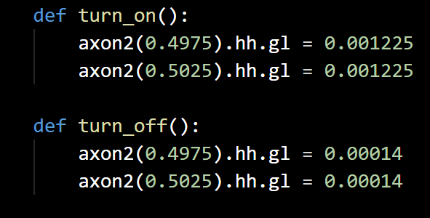
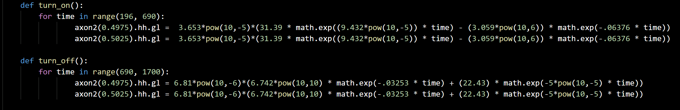
Equations in NEURON
Fig 4. Equations with Scaling Factor

Slide 5
Action Potential Initiation Inhibition
Current measured from 5000 µm
Potential difference measured from 5300 µm

Slide 6
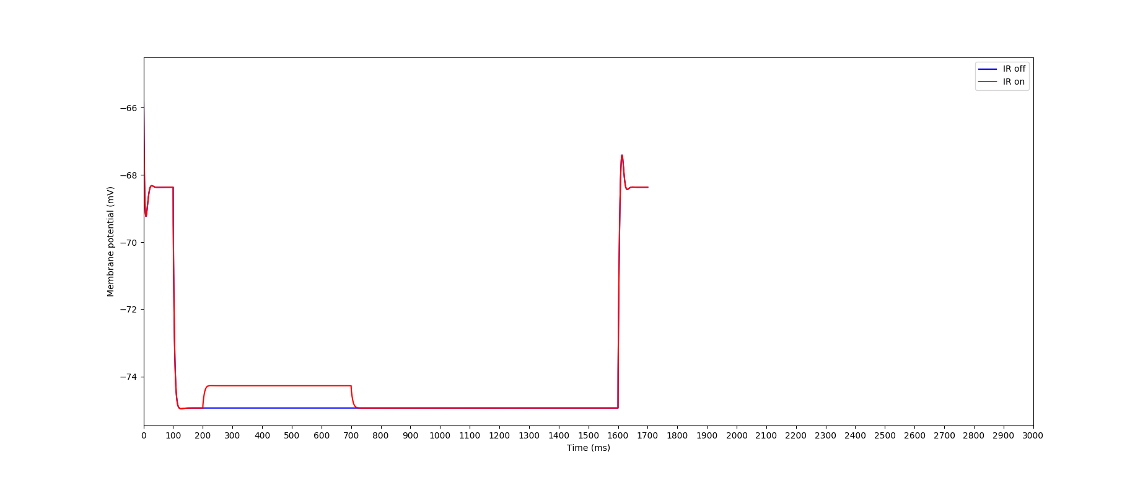
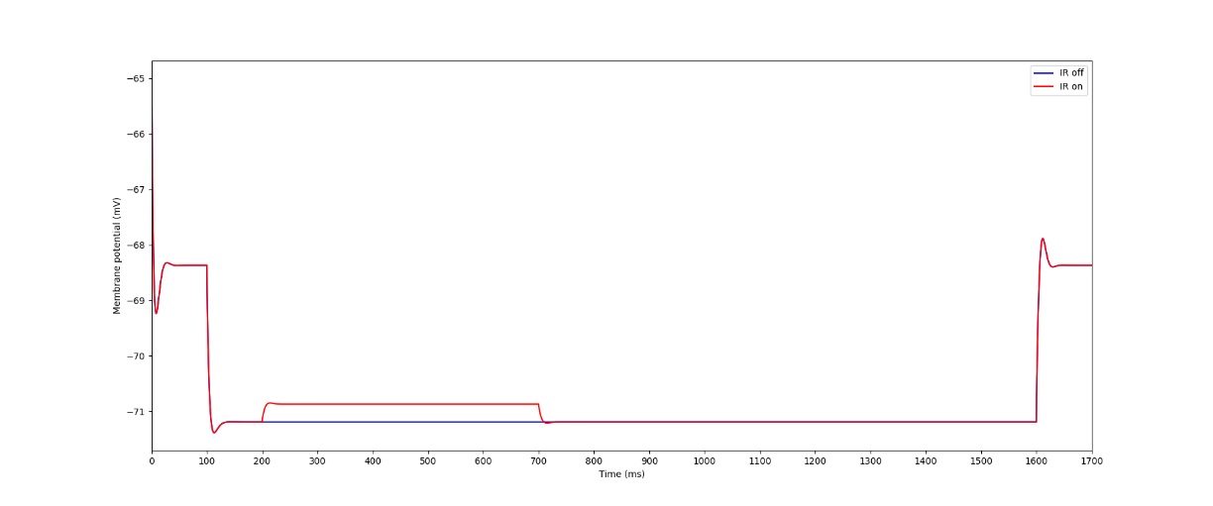
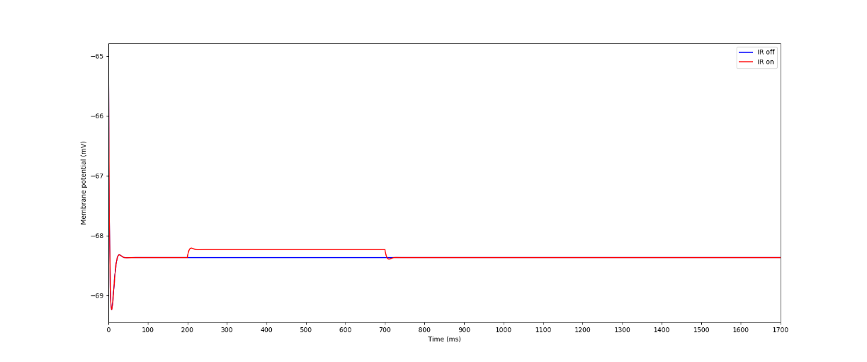
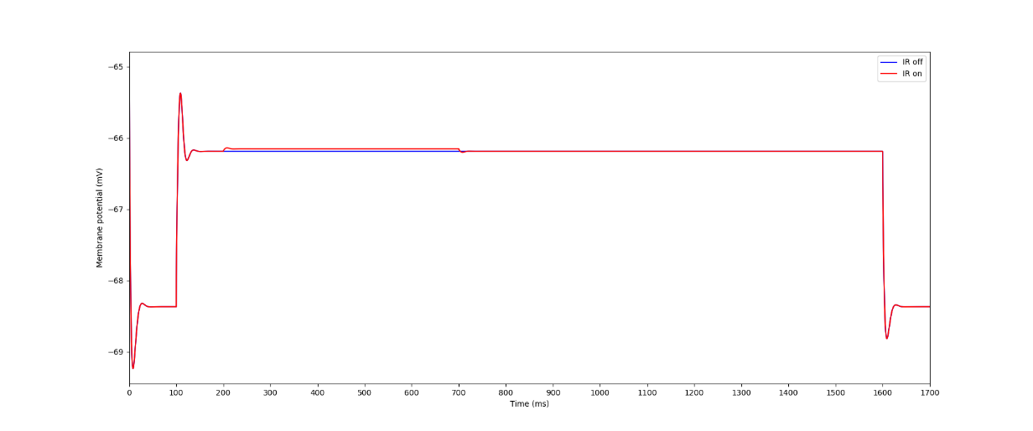
Varying Current with new Equations
Fig 5. -10 nA
Fig 7. 0nA
Fig 6. -5 nA
Fig 8. 5 nA

Slide 7
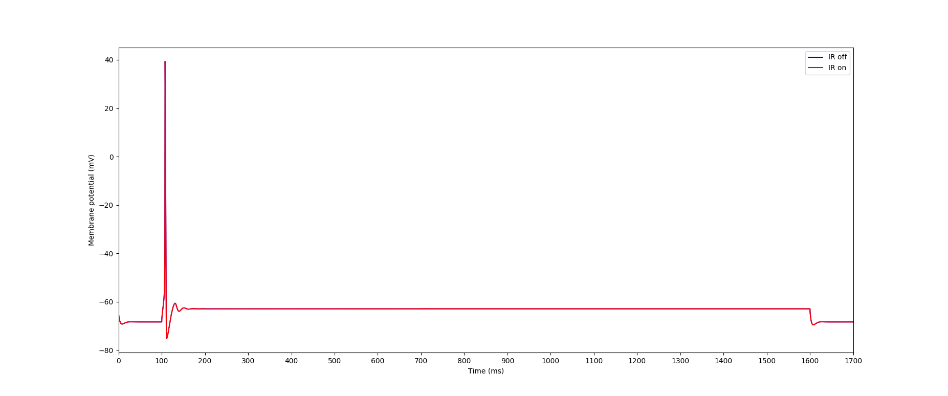
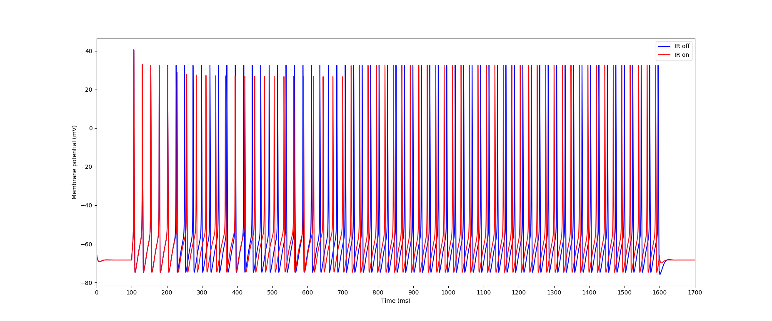
Varying Current cont.
Fig 9. 15nA
Fig 10. 20nA
There is a sharp increase in the amount of action potentials between 15nA and 20nA

Slide 8
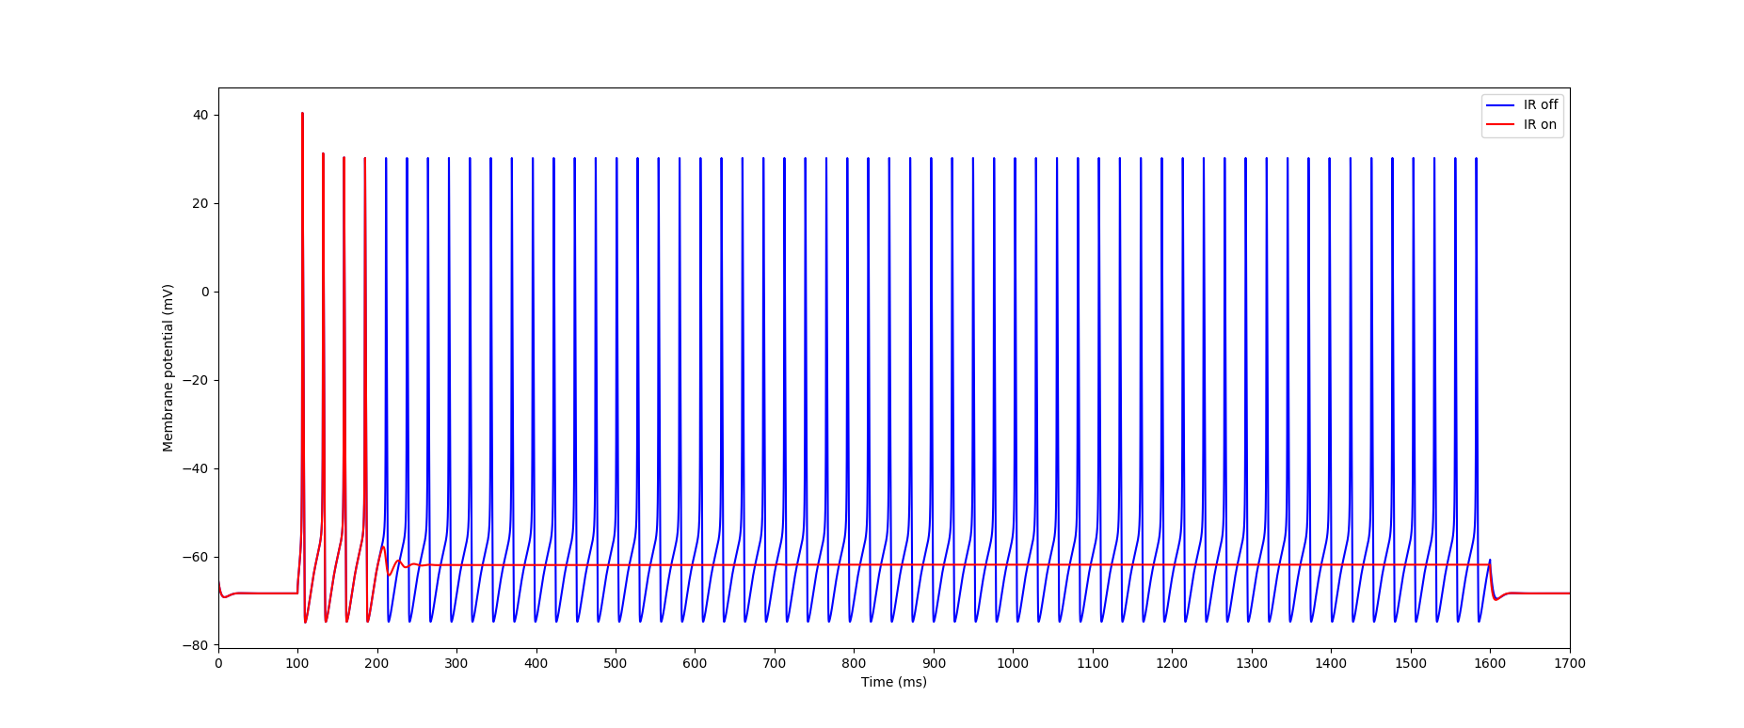
Fig. 11 - i = 19nA
When the IR is activated with an injection current of 19nA, the membrane potential does not recover to that of the off IR

Slide 9
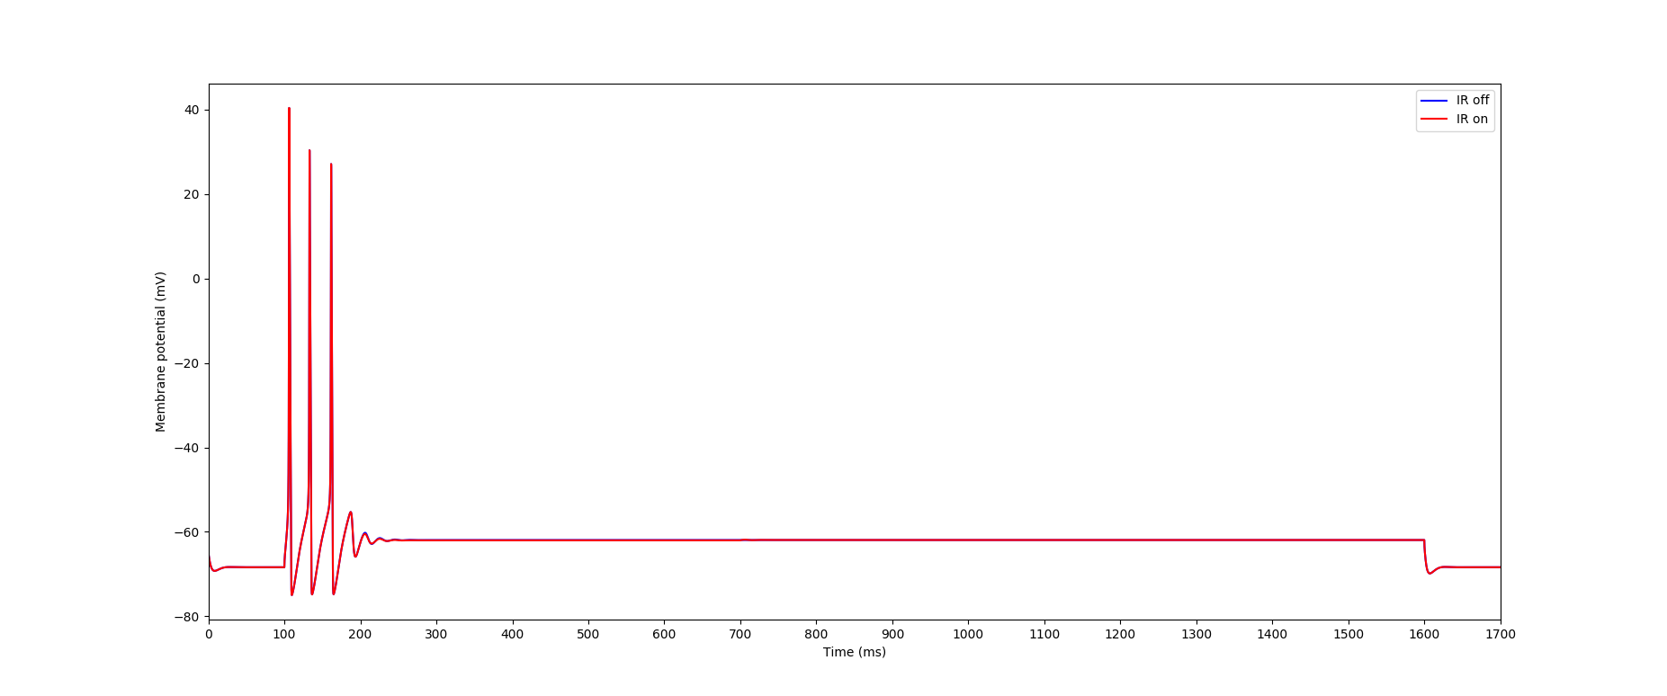
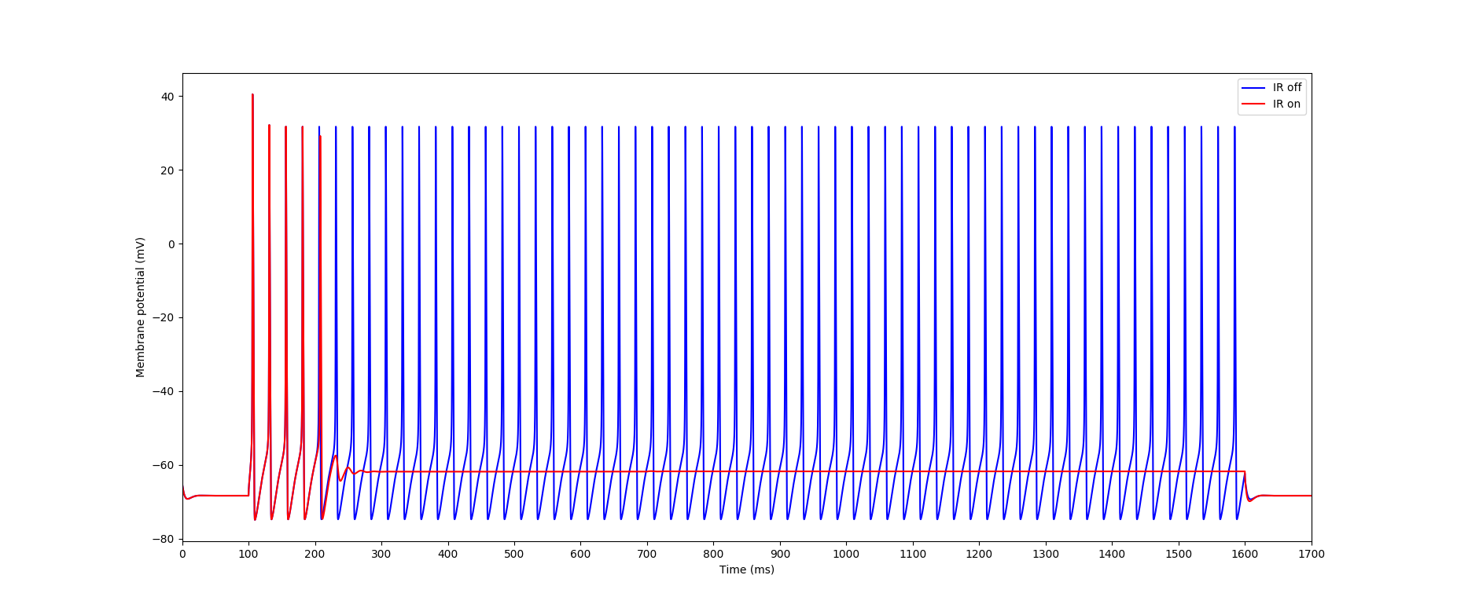
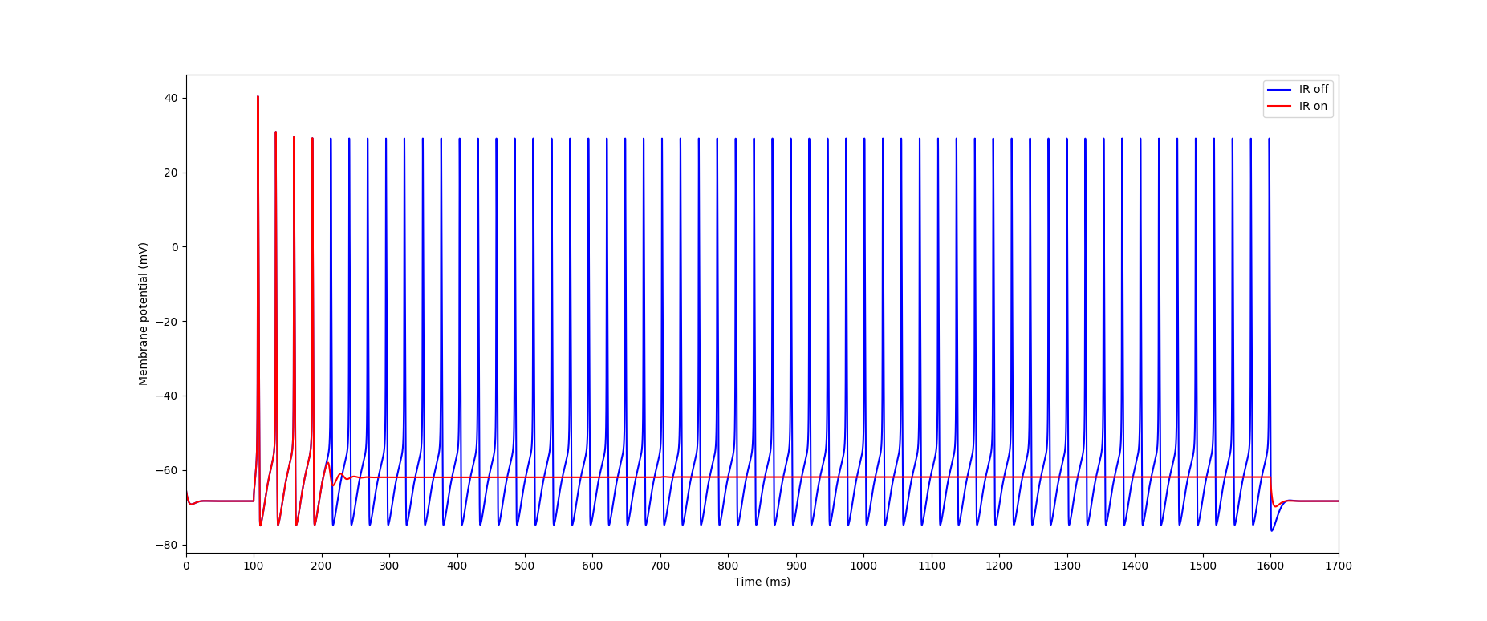
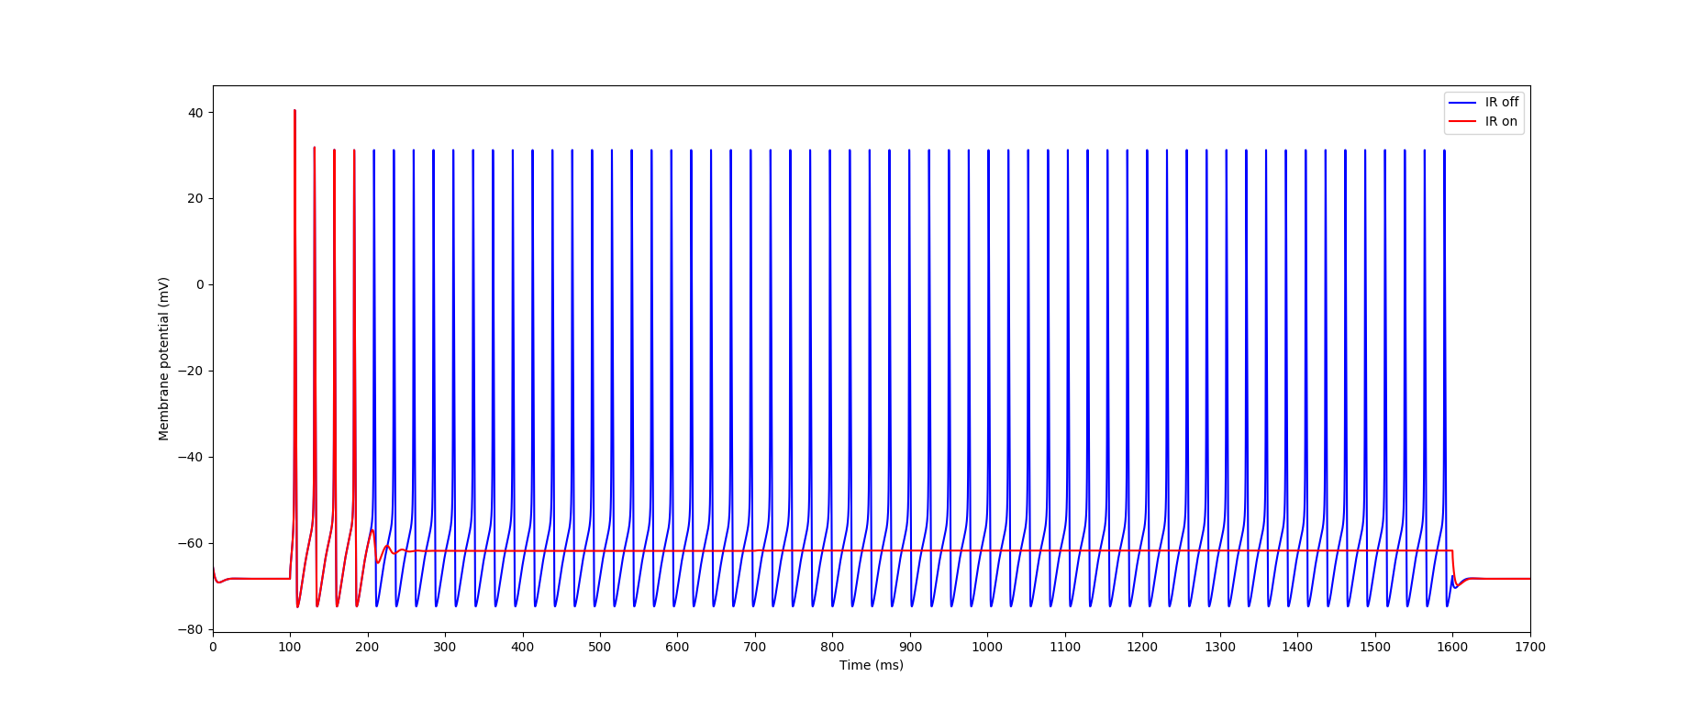
Nearby Plots
Fig 12 – 18.75 nA
Fig 14 – 19.4 nA
Fig 13 – 18.8 nA
Fig 15 – 18.75 nA

Slide 10
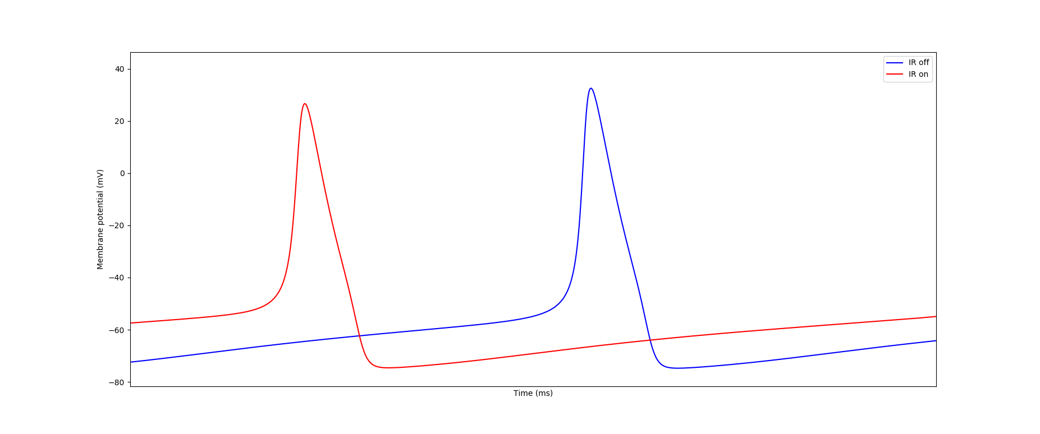
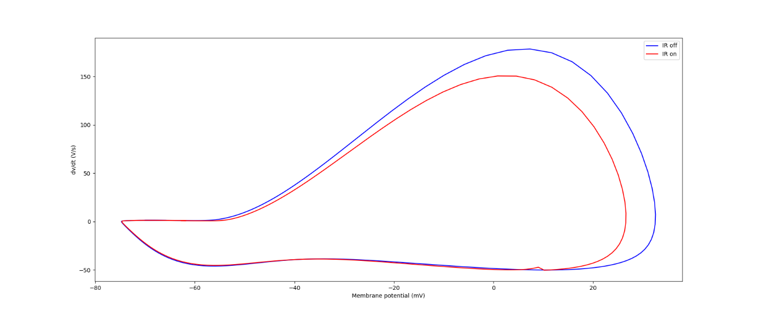
Enlarged Action Potential and Phase Plot
Fig 16. Twin Action Potentials
Fig 17. Twin Phase Plots
Parameters:
865ns < t < 885ns
i = 20nA
Injected at 5000 µm

Slide 11
Action Potential Propagation Block
Current is injected at 10 µm
Voltage is measured at 6000 µm

Slide 12
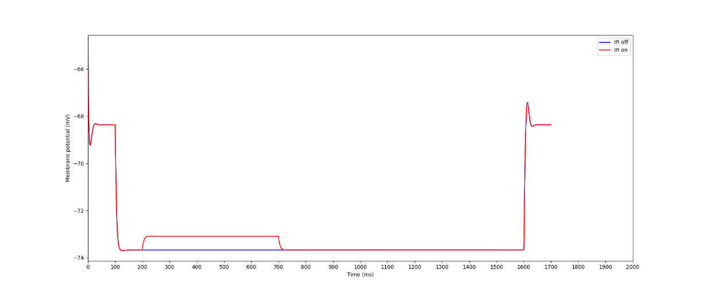
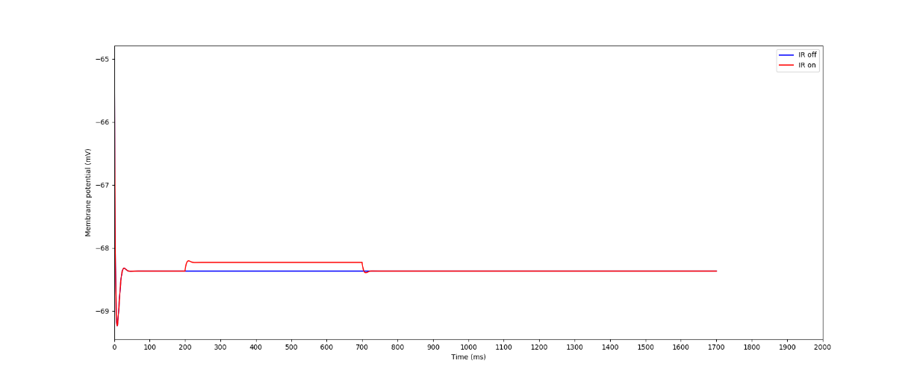
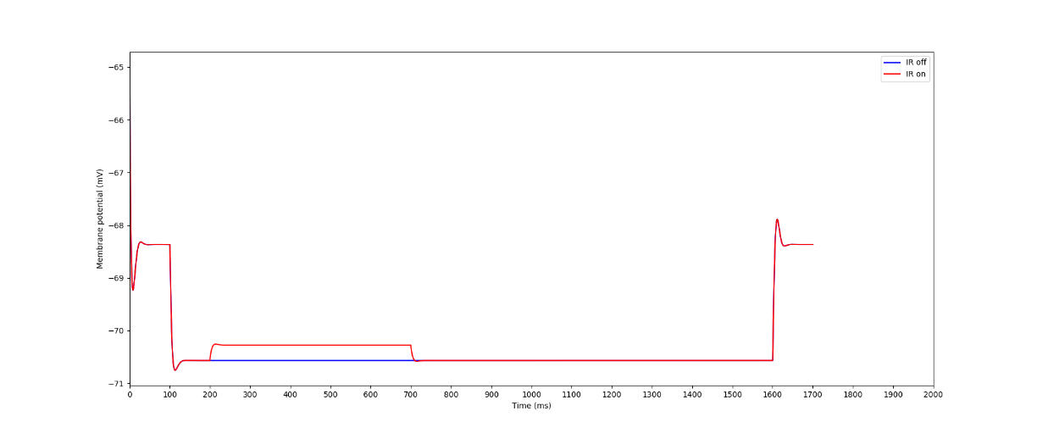
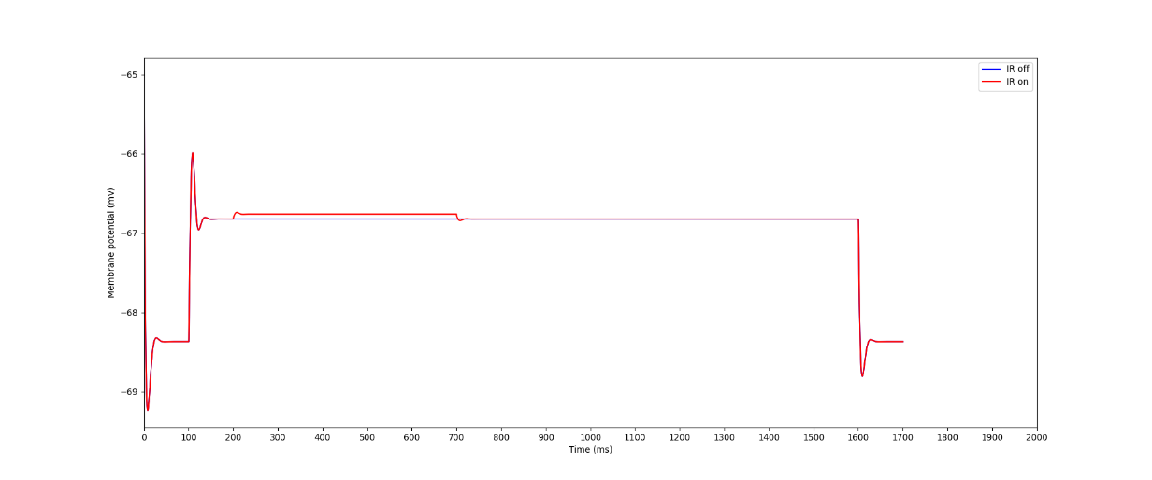
Varying Current
Fig 18. -10 nA
Fig 20. 0nA
Fig 19. -5 nA
Fig 21. 5 nA

Slide 13
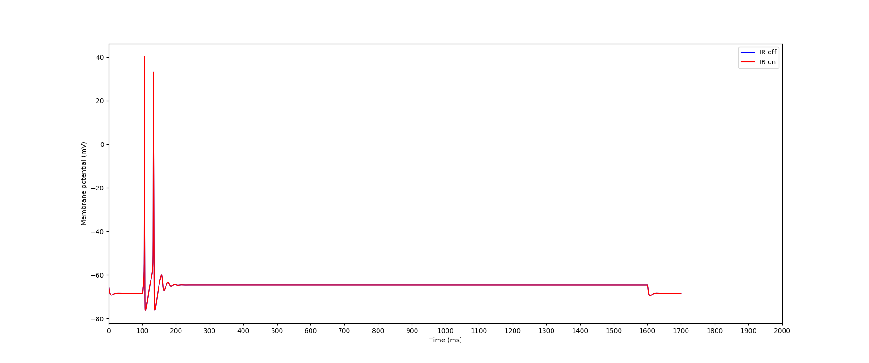
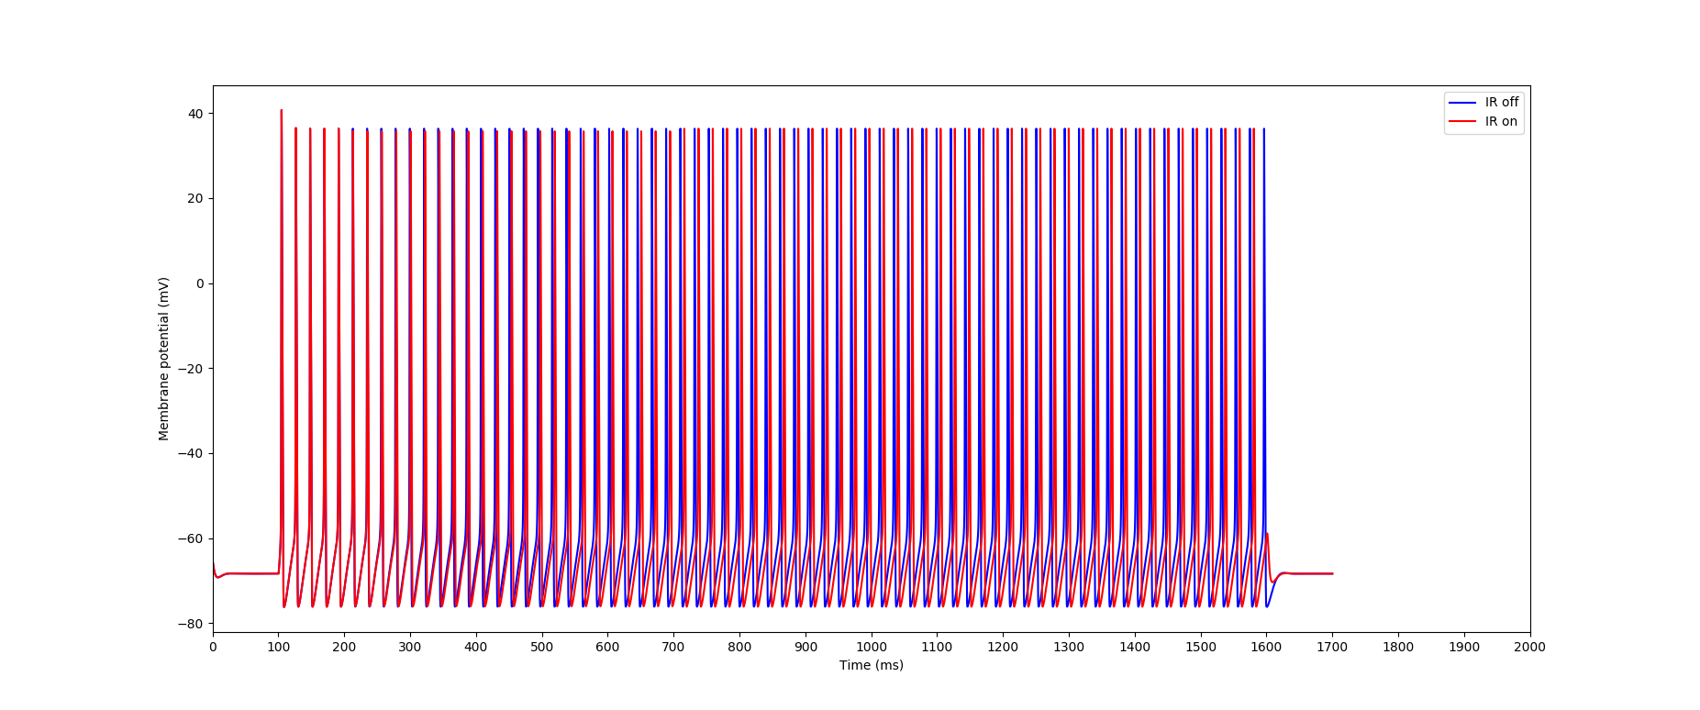
Varying Current cont.
Fig 22. 17nA
Fig 23. 20nA
There is a sharp increase in the amount of action potentials between 17nA and 20nA

Slide 14
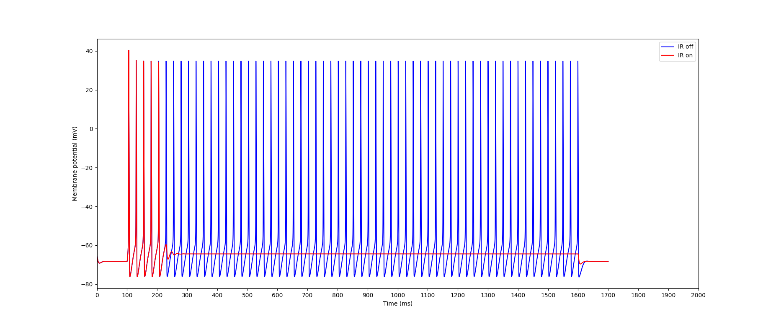
Fig. 24 - i = 17.6nA
When the IR is activated with an injection current of 17.6nA, the membrane potential does not recover to that of the off IR

Slide 15
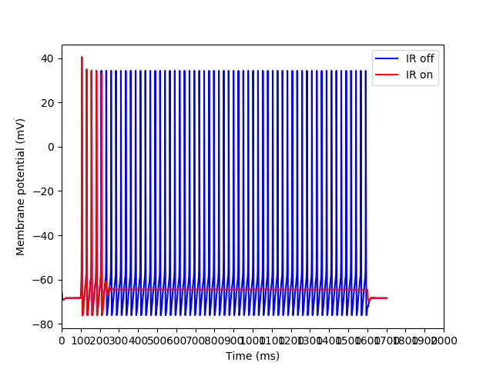
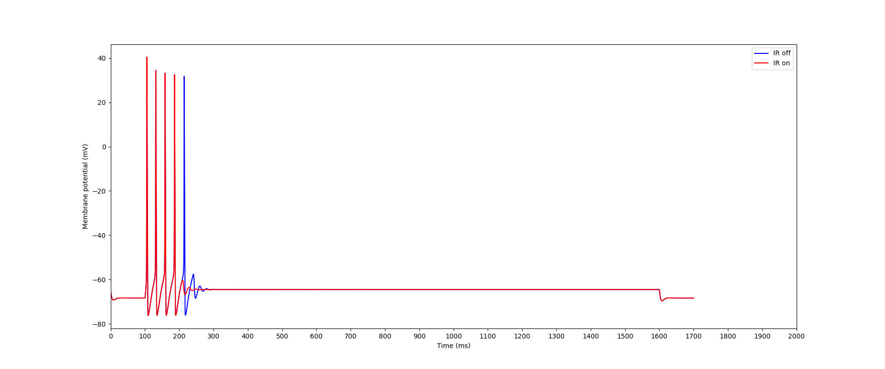
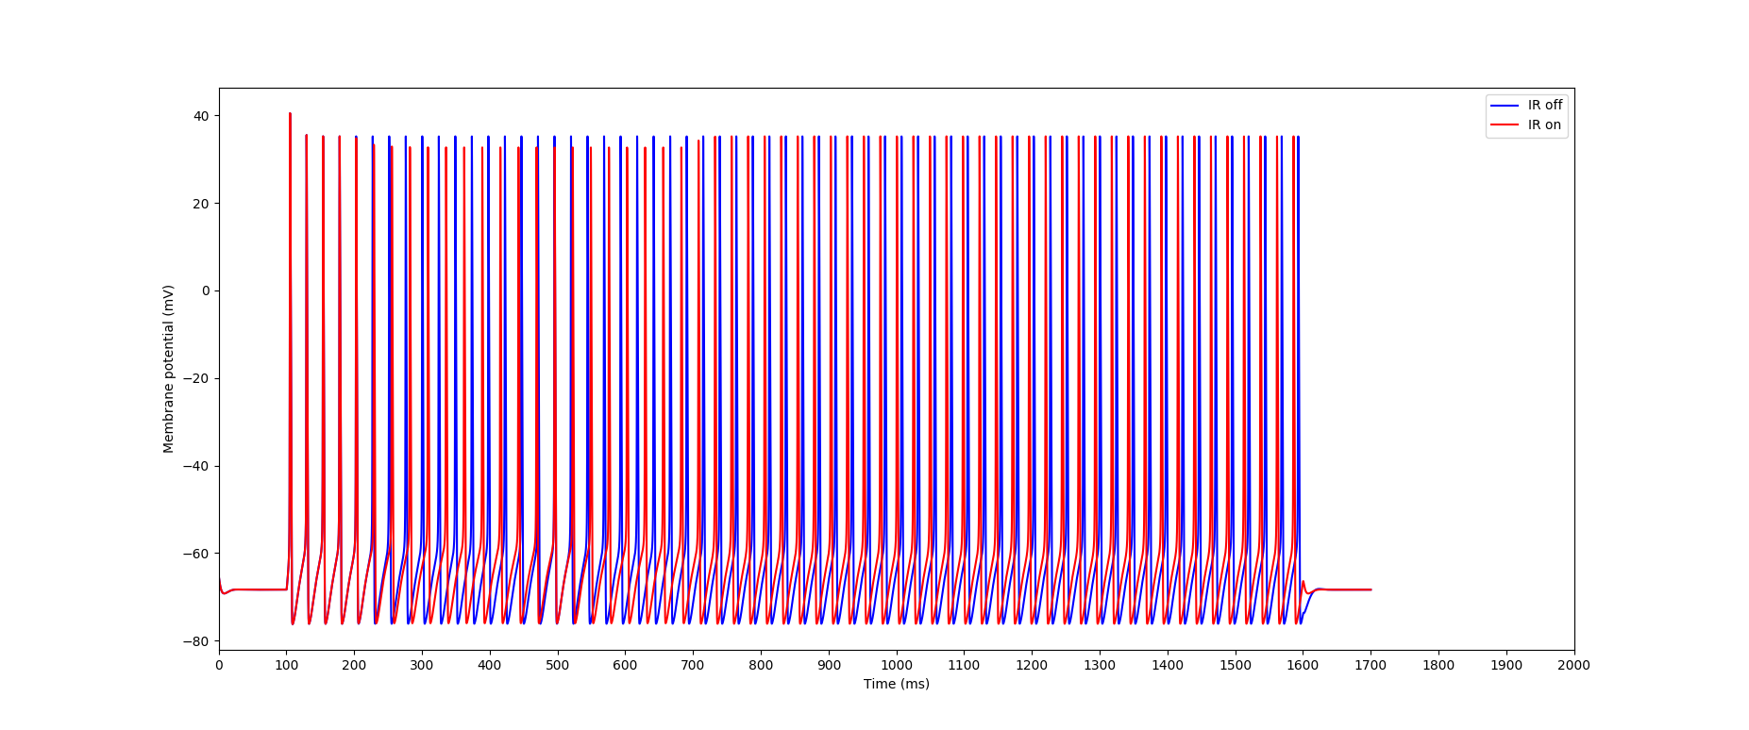
Nearby Plots
Fig 25 – 17 nA
Fig 27 –17.4 nA
Fig 26 – 17.2 nA
Fig 28 – 17.8 nA

Slide 16
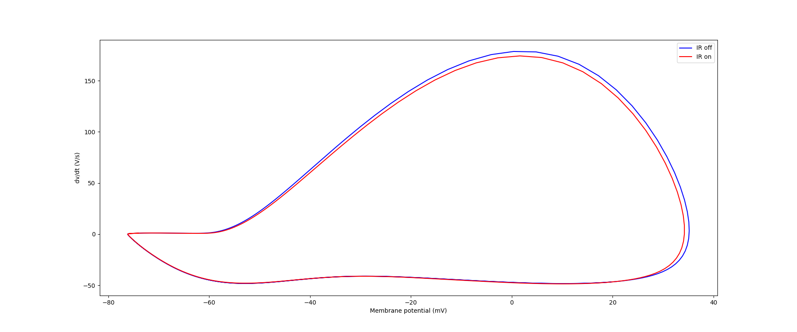
Phase Plot – i = 17.8 nA

Slide 17
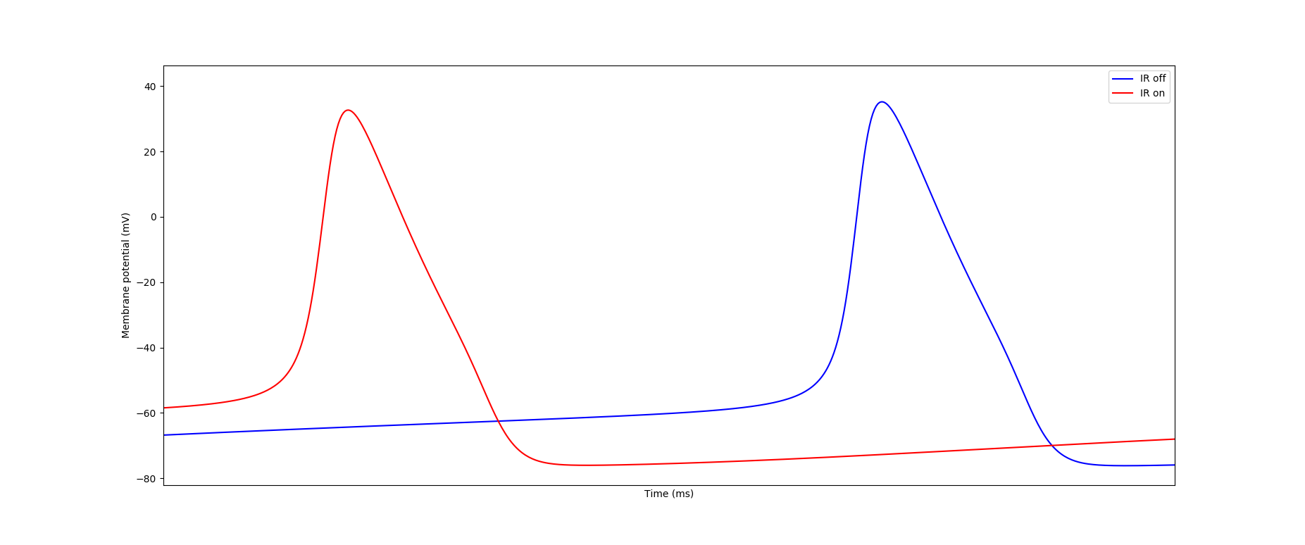
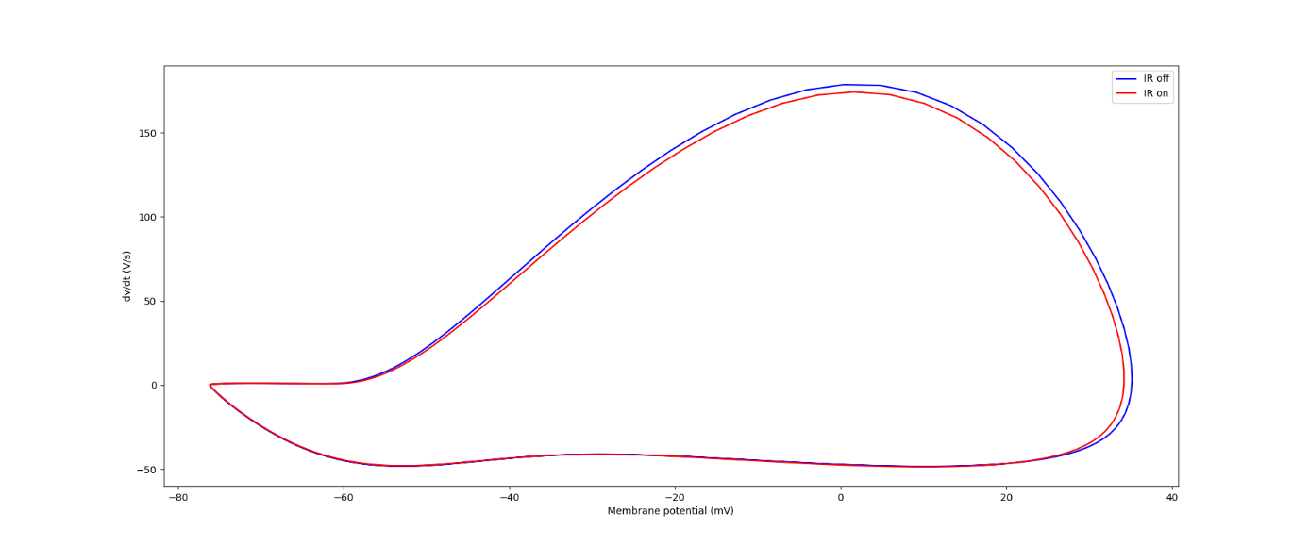
Enlarged Action Potential and Phase Plot
Fig 29 - Twin Action Potentials
Fig 30 - Twin Phase Plots
Parameters:
890ns < t < 900ns
i = 20nA

